Slide 1
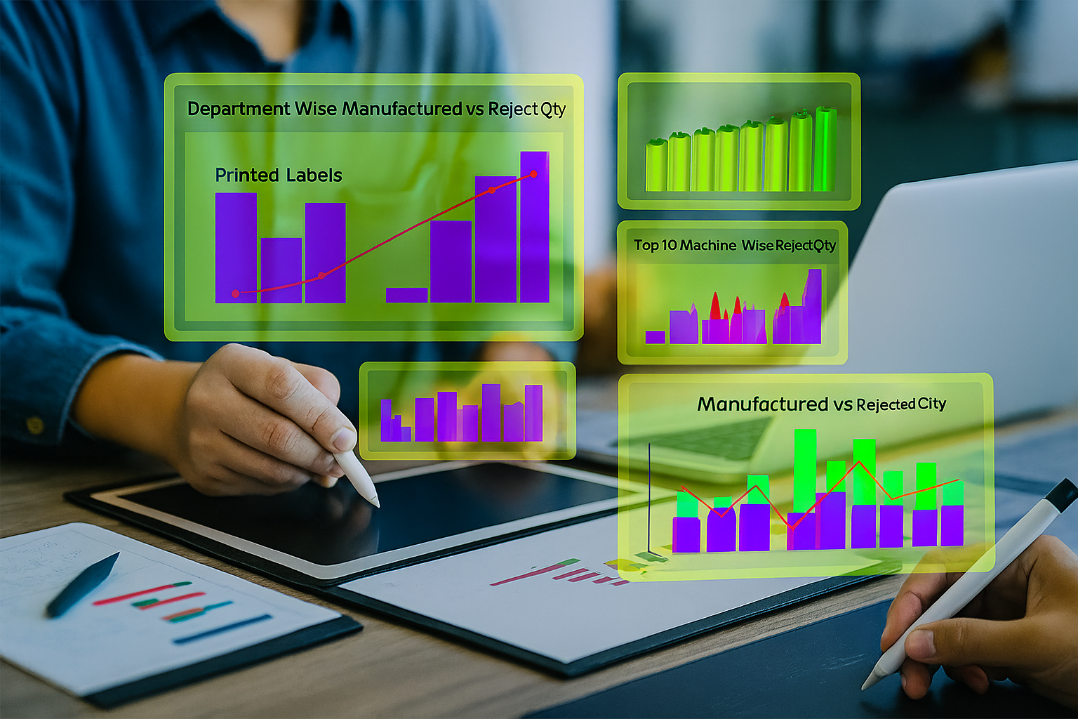
Manufacturing Performance Analysis Project
CONTENTS
1. Introduction
2. Data Overview
3. Objectives and KPIs
4. Process
6. Recommendations & Insights
7. Conclusions
8. Challenges and Learnings
9. Final Report

Slide 2




Slide:1 Introduction
The Manufacturing Analytics project aims to analyze large-scale production data to identify trends, improve operational efficiency, and optimize manufacturing processes. Through the use of Excel, Tableau, SQL, and Power BI, the data was transformed into meaningful insights, supporting data-driven decisions across departments, machinery, and workforce performance.
Tools used

Slide 3
Slide:2 Data Overview
Understanding the Data
The dataset consists of detailed production records, machine and employee data, and department-level performance.
It was designed to track manufacturing quantities, rejections, production costs, and wastage across different operational units.
Dataset | Purpose | Key Fields | Data Cleaning Tasks
Production Data | Tracks daily production and rejection quantities | Date, Department, Machine Code, Employee Code, Manufactured Qty, Rejected Qty, Produced Qty | Removed nulls, corrected data types, formatted dates
Machine Master | Machine details by department | Machine Code, Machine Name, Department | Checked for duplicates, aligned codes
Employee Master | Employee details | Employee Code, Name, Department, Shift | Normalized names, validated department codes

Slide 4
Slide: 3 Objectives and KPIs
Defining Objectives and Key Metrics
Objectives
Key Metrics
KPI Name | Purpose | Formula / Logic | Expected Output Format
Manufactured Qty | Measures total items produced | SUM(Manufactured Qty) | 86.77 (M)
Rejected Qty | Items not meeting quality standards | SUM(Rejected Qty) | 524.73 (K)
Produced Qty | Final accepted items post rejection | SUM(Produced Qty) | 86.24 (M)
Wastage Rate (%) | Efficiency indicator for losses | (SUM(Rejected Qty) / (SUM(Manufactured Qty) - SUM(Rejected Qty))) * 100 | 0.608%
Total Employees | Total workforce involved | DISTINCTCOUNT(Employee Code) | 129
Total Machinery | Total active machines | DISTINCTCOUNT(Machine Code) | 87
Manufacturing Cost | Daily cost of production | SUM(Total Manufacturing Cost) | ₹ 12.77 (M)
To track manufacturing output across departments and machines.
To measure wastage and rejection rates accurately.
To identify underperforming machines and employees.
To analyze cost impact and efficiency improvements.
To visualize key manufacturing metrics interactively for management.

Slide 5


Slide:4 Process
Data Transformation & Analytical Process
The process involved four analytical layers that together built a complete data intelligence workflow:
Data Cleaning & Preparation
KPI Formulation
• Performed in Excel, SQL, and Power BI Query Editor.
• Developed metrics using Excel formulas, Tableau calculated fields, and Power BI DAX.
• Removed missing values, standardized formats, validated joins.
• Unified logic across tools to ensure consistency.
Validation & Cross-Checking
Visualization Development
• Created interactive dashboards with slicers, parameters, and drill-throughs.
• Used SQL queries to verify totals and KPI outputs before visualization.

Slide 6
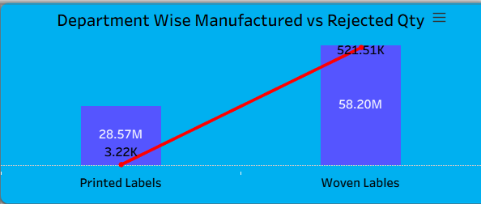
Slide:5 Manufacturing Performance Analysis & Dashboard Insights
Chart 1: Department-Wise Manufactured vs Rejected Quantity
Visualization Type: Clustered Column & Line Chart
Purpose: Compare production scale and rejection rate at the department level.
Insights:
Woven Labels Department produced 58.20M units, the highest among all, with 521.51K rejections.
Printed Labels Department followed with 28.57M manufactured units and 3.22K rejected units.
Despite higher production, Woven Labels also reflects a significantly larger rejection rate, suggesting potential process inefficiencies or material variation.

Slide 7
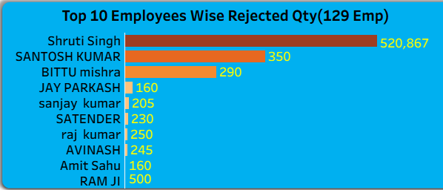
Manufacturing Performance Analysis & Dashboard Insights
Chart 2: Top 10 Employees by Rejected Quantity
Visualization Type: Horizontal Bar Chart
Purpose: Identify employees contributing to the highest rejection volumes.
Insights:
Shruti Singh, Santosh Kumar, and Bittu Mishra recorded the top 3 rejection totals (520K+, 350K, 290K respectively).
A steep drop is seen after the top performers, indicating rejection issues are concentrated among a small employee segment.
Suggests possible skill gaps, inadequate training, or machine alignment issues for those specific operators

Slide 8
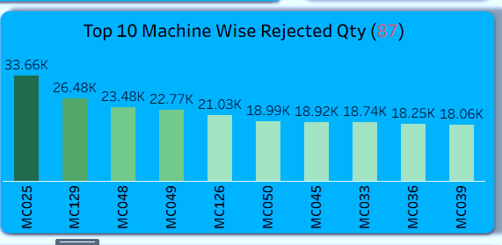
Manufacturing Performance Analysis & Dashboard Insights
Chart 3: Top 10 Machines by Rejected Quantity
Visualization Type: Vertical Column Chart
Purpose: Pinpoint machines producing the highest volume of rejected goods.
Insights:
MC025, MC129, and MC048 lead in rejection output (33.6K, 26.4K, and 23.4K respectively).
Gradual decline toward MC039 (18.0K) shows consistent performance variation among machines.
Machines in the MC025–MC050 range appear to be older or more prone to calibration errors.

Slide 9
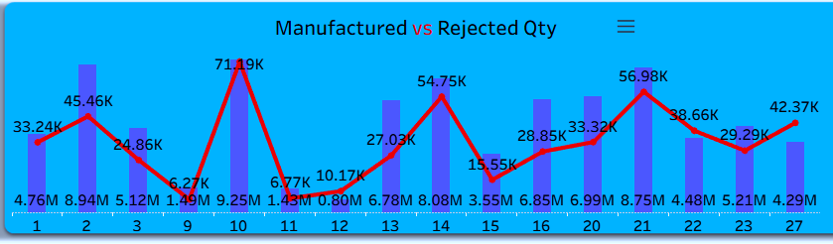
Manufacturing Performance Analysis & Dashboard Insights
Chart 4: Manufactured vs Rejected Quantity (Overall Trend)
Visualization Type: Combined Column & Line Chart (Date-wise)
Purpose: Analyze production and rejection trends over time.
Insights:
Notable production spikes on specific days (Day 10, Day 21) correspond with rejection peaks (71.19K, 56.98K).
The relationship indicates rejection increases proportionally with higher production volumes.
Lower production days (e.g., Days 6–8, 11–12) show minimal rejection, emphasizing process control effectiveness under moderate loads.

Slide 10
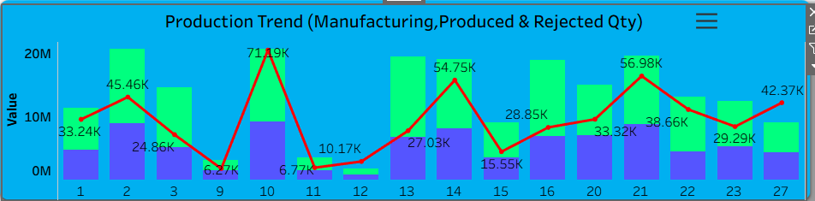
Manufacturing Performance Analysis & Dashboard Insights
Chart 5: Production Trend (Manufactured, Produced & Rejected Quantity)
Visualization Type: Multi-Metric Column & Line Chart
Purpose: Visualize overall performance across all production outcomes.
Insights:
The Produced Quantity closely follows Manufactured Quantity, except during high-rejection peaks (Day 10, Day 21).
The red line (Rejection Trend) clearly visualizes efficiency dips aligning with maximum output days.
The green columns (Produced Qty) reflect recovery in subsequent cycles, suggesting corrective actions are already influencing stability

Slide 11
Slide:6 Recommendations & Insights
Key Findings and Strategic Recommendations
Area | Insight | Recommendation
Department Performance | Department A has highest production but also high cost | Review cost-efficiency programs
Machine Efficiency | Machine M-102 underperforms repeatedly | Schedule maintenance and calibration
Employee Trends | Certain employees show higher rejection rates | Conduct targeted skill training
Wastage Control | Wastage average is 5.3% | Introduce stricter QC measures and material handling practices
Production Cost | Cost increases during peak months | Analyze cost drivers (energy, manpower) for optimization

Slide 12

Slide:7 Challenges and Learnings
What We Faced and What We Learned
Challenges
Learnings
• Formatting inconsistencies (Million vs Thousand representation).
• Advanced DAX, Tableau formulas, and SQL aggregation logic.
• Designing KPIs that tell a business story.
• Linking fiscal date parameters across dashboards.
• Building relationships and models across datasets.
• Creating accurate calculated fields in Tableau and DAX formulas in Power BI.
• Applying visual hierarchy and color consistency in BI tools.
• Managing secondary axis scaling and chart visibility.
• Understanding end-to-end data flow from raw extraction to dashboard presentation.
• Integrating multiple sources without redundancy.

Slide 13
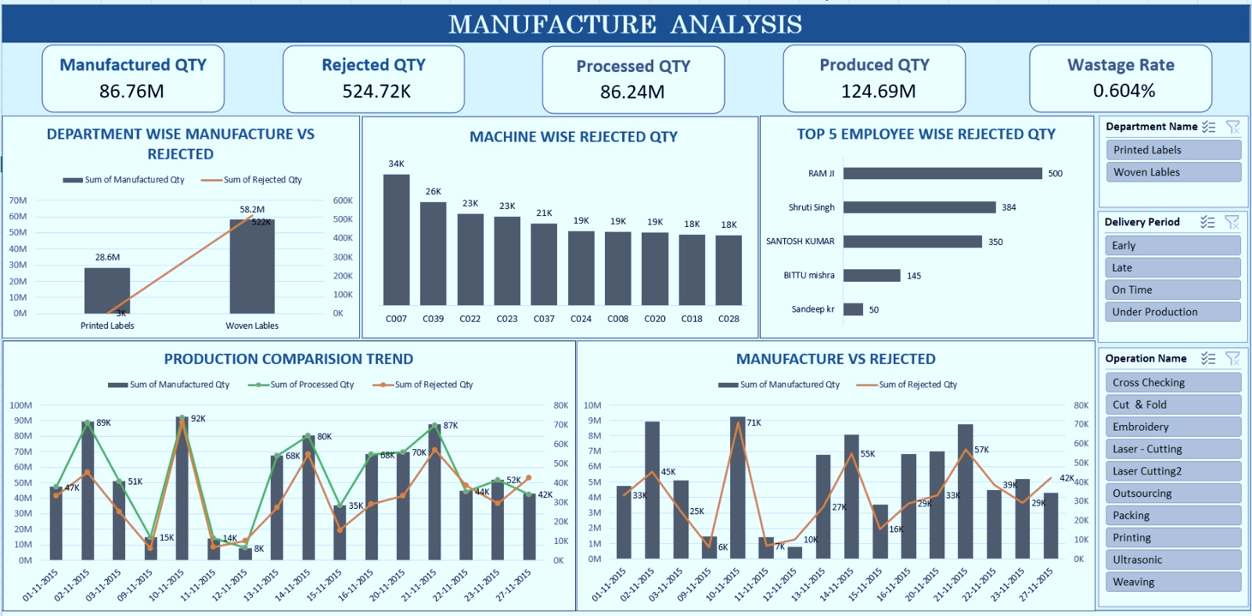
Slide:8 Final Report
EXCEL: MANUFACTURING ANALYTICS DASHBOARD

Slide 14
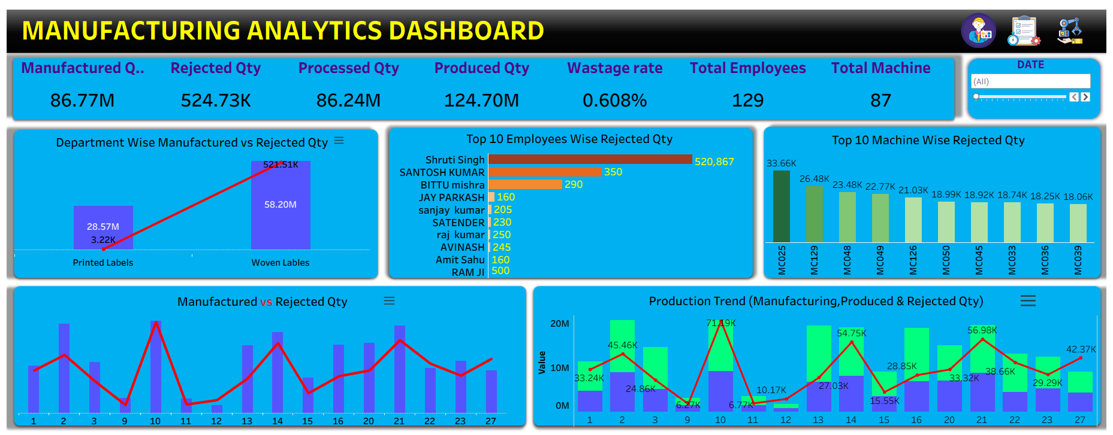
Final Report
TABLEAU: MANUFACTURING ANALYTICS DASHBOARD

Slide 15
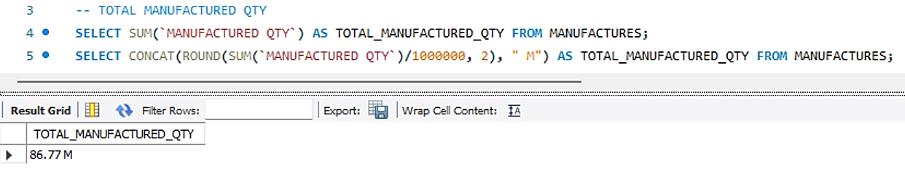
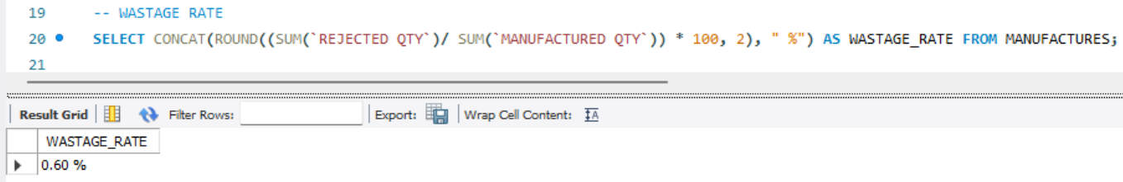
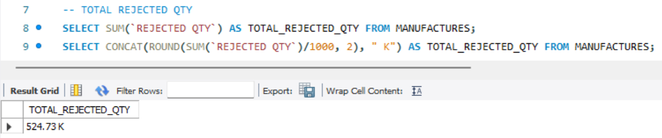
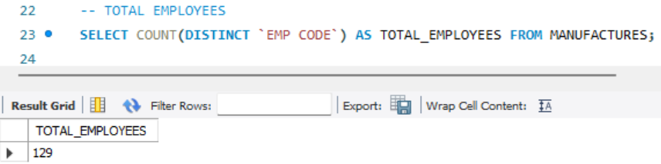
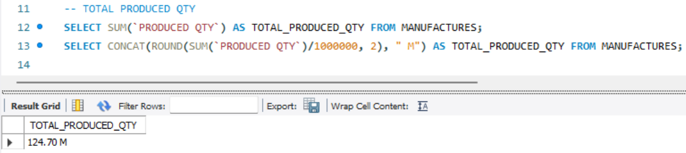
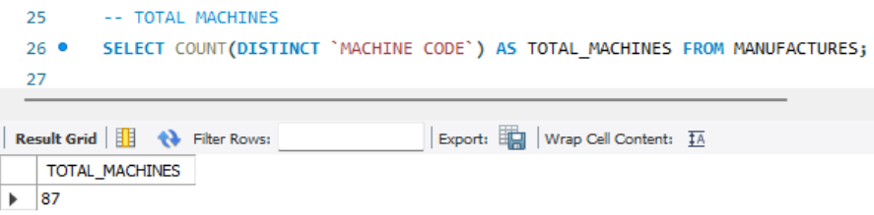
Final Report
My-SQL: MANUFACTURING ANALYTICS QUERIES

Slide 16
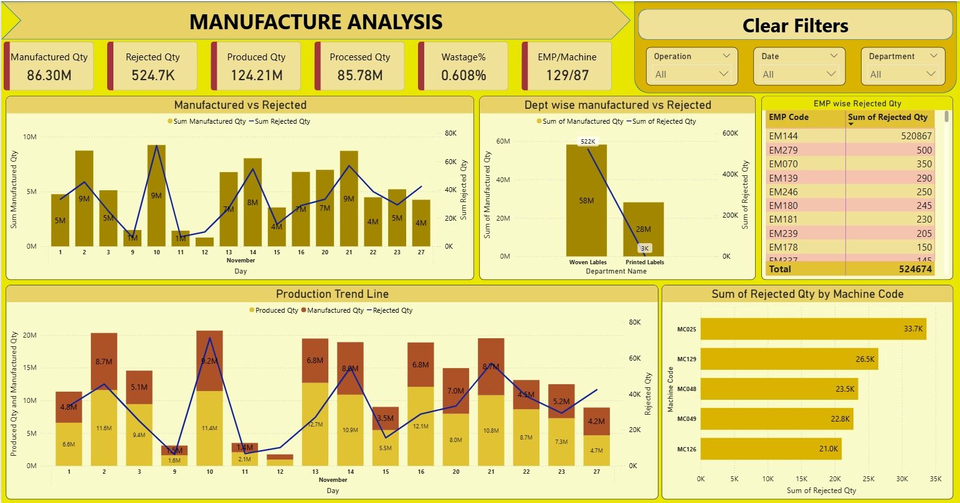
Final Report
POWER BI : MANUFACTURING ANALYTICS DASHBOARD

Slide 17




Slide:9 Conclusions
🎯 Project Summary
This project aimed to analyze and visualize manufacturing operations to monitor production efficiency, rejection patterns, and overall performance across employees, machines, and departments.
Using Excel, SQL, Tableau, and Power BI, the dataset was explored, cleaned, and transformed into meaningful insights through dashboards and KPIs.
1
2
3
4
Woven Labels emerged as the most productive yet also the most rejection-prone department.
This project aimed to analyze and visualize manufacturing operations to monitor production efficiency, rejection patterns, and overall performance across employees, machines, and departments.
A few employees and machines contribute significantly to total rejections suggesting a need for focused quality training and maintenance schedules.
Daily and trend analyses reveal operational peaks and quality dips, emphasizing the importance of stable workloads and continuous monitoring.

Slide 18
Thank You

